Slide 1
Linux, Python, Markov and Bayes

Slide 2
Housekeeping
Who here would consider themselves to have an advanced background in Linux?
Ask related questions here
Quiz on ELMS in the future?
Quiz on non-neural-net ML next week
Optional Python and Linux homeworks on ELMS
If the quiz was hard for you something is very wrong
Matts grading quizzes, mistakes can happen
Particularly with answers that are right that we didn’t mention in class
See either of us after a class or email Matt
Raise your hand if you want me to review Baye’s Theorem, understanding it well will be important for class today
The Linux slides are missing a ton of stuff so I’m just going to largely do that section off the top of my head

Slide 3
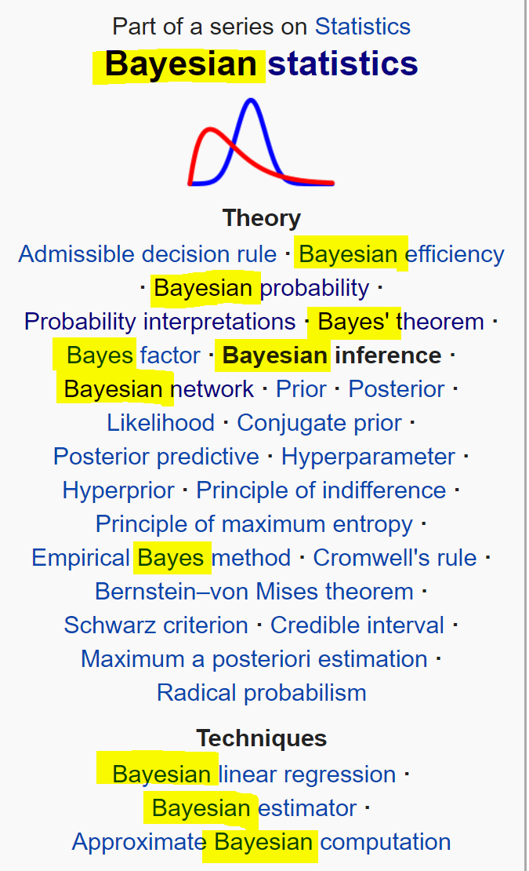
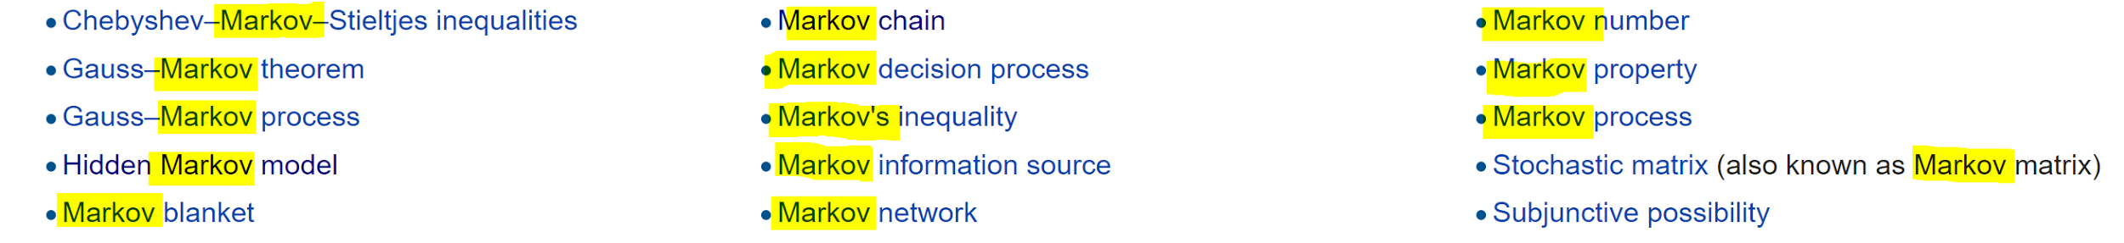
I apologize for the naming in this field
A dead white man named Thomas Bayes invented a lot of statistics and probability
Hence the statistics/probability humans deal with is formally called Bayesian statistics/probability
Technically it’s one mathematically equivalent “interpretation” of probability
Mathematicians locked in rooms too long created others to prove it could be done
After he died, other people named a bunch of related things to him after his work
I don’t understand why
The same thing happened to Andrey Markov, who basically invented how to handle models of evolving random variables
Many things here have multiple names that are in real use
Everything is word soup if you try to read about this stuff on a cursory level
“If words don’t have meaning anymore, then why should numbers?”- John Oliver

Slide 4
Bayes Theorem
https://www.youtube.com/watch?v=R13BD8qKeTg

Slide 5
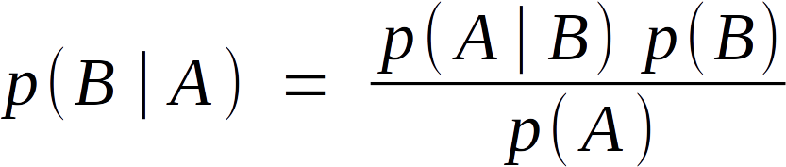
Naive Bayes
Assuming independent variables (hence naive), construct simple probabilistic p(n₁,...,n_{n})=f(n₁,...,n_{n}) via looking at data and algorithmically reverse engineering Bayes theorem from the data
Performs very well on small amounts of data
Only works well on simple things
Can’t detect things that change based on multiple variables
Isn’t too bad about over fitting
Rather similar to decision trees
Sk learn

Slide 6
Bayes Inference/Updating/Rule
If you predict an outcome given conditions via any model, and get new data, the probability can be corrected via a weird hijacking of Bayes’s theorem
This can help prevent retraining or anomalies in other methods of adding data
From wikipedia:

Slide 7
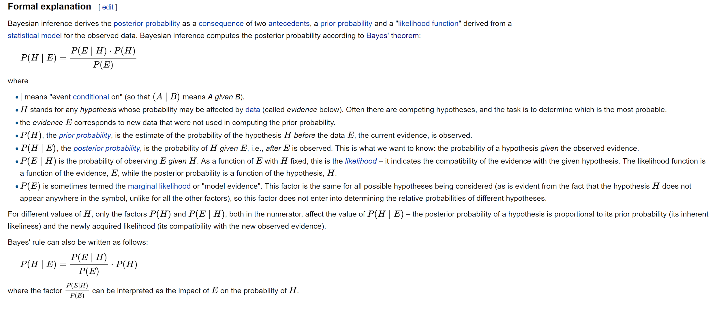

Slide 8
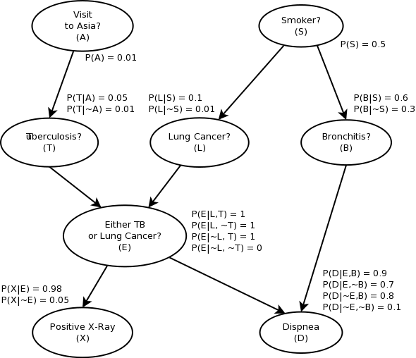
Bayes/Belief Nets
Very different than Naive Bayes
Construct and train Directed Acyclic Graph (DAG) on data
Remarkably high data compression rate compared to each individual probability
They can actually be made to be as accurate as the data is, and the nature of the probability distribution lets them have a well defined algorithm for optimization
One of the original ML techniques, tons of well defined theory in math and CS on how they work
Advantages
Produce very good probabilistic predictions
Scale well across large data sets
Fairly understandable, not really a black box
Disadvantages
Can’t do many other things

Slide 9
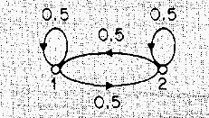
Hidden Markov Model
Really good introductory paper
Basically time series version of Bayes net
Markov process: stochastic system that satisfies “Markov Property” or “memorylessness”, finite number of states, continuous or discrete
P(s_{n})=f(s_{n-1}), explicitly excludes P(s_{n})=f(s_{n-m}) where m!=1
Describable by Markov Chain/Model
If only outcomes are observable, and the model therefore may be based on hidden variables, you can find them using a creatively named Hidden Markov Model
Well defined complicated math way of building this model, like with Bayes net
Can be used for speech prediction and lot’s of time series models
Pretty much same pros and cons as Bayes net
SK learn fork

Slide 10
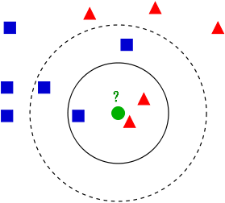
k nearest neighbors (k-NN)

Slide 11
Dimensionality reduction
Autoencoders, obviously
More mathy ways of doing this that may be useful due to being unsupervised, faster, and more transparent than neural nets
They’re all permutations of Principal Component Analysis (PCA), which is just doing the mapping via lots of linear algebra to globally minimize variance between data and the new dimensions

Slide 12
The time I built my own personal pirated Netflix server

Slide 13
Legal disclaimer: I never actually did the things I say I did in the following. Piracy is is wrong and should not and is never done by anyone. Don’t try this at home.

Slide 14
A brief rant about the streaming industry
Many major US shows and movies aren’t available for streaming period
Simpsons, Office Space, Monk, Disney Movies, etc
Many more require you going to the depths of subscribing to Hulu
Less than 10% of people our age watch “TV”
The people deciding to still go along with this are using fake math
“There is a fundamental misconception about piracy. Piracy is almost always a service problem and not a pricing problem.”- Gabe Newell
When John Oliver did HBO’s official release video for their online streaming service being purchasable online and not requiring a cable description, he called it “Like the old HBO, except now you don’t have to use your parents account”
How can you be this bad at doing things and still be allowed to do them
Fake math
Watching content from overseas or while overseas is even worse
Netflix’s subs are generally absolutely unusable and I don’t understand why
Crunchyroll doesn’t have lots of major things either
Much of this that remains is due to Fox’s famously brilliant executive management and somewhat more reasonable protectionist policies by Disney
Much of this will be resolved by Disney creating the first real competitor to Netflix
Mass sport and Fox acquisitions

Slide 15


Large, mostly open source “Netflix” software
Runs on about as many things as Netflix too
Officially intended for people ripping old DVD, etc

Slide 16
Problems using Windows as my server OS
NTFS was slightly ruining my life
Long term stability issues
Windows update
Ridiculous weird configuration problems
Performance issues, especially for networking
So I tried Linux
No “just use Windows 7” is not an actual solution to anything

Slide 17
Notes on command line interfaces (CLIs)

Slide 18
What’s Linux

Slide 19
Advantages of Linux
Free
Stability (space station)
BASH
Servers
Infinite extensibility
Code interaction
“Perfect”
Security
Adaptability to different platforms

Slide 20
Advantages of Linux
Better performance/lower overhead
Infinitely customizable/modular
Open source
Bugs
Epistemology
Package manager
Works on supercomputers
Getting away from NTFS
Programmer/server/mobile specifics tools
Industry developers

Slide 21
Limitations of Linux
Learning curve
Can’t run some games
Can’t run some creative programs
Some things have bad or no UI
UI can be buggy
Driver anomalies
Slow backpropogation

Slide 22
Linux Distros
https://upload.wikimedia.org/wikipedia/commons/1/1b/Linux_Distribution_Timeline.svg
Debian, Arch, SUSE, Gento, Redhat
Use Ubuntu for desktops, I recommend with GNOME
Don’t ever pick something super weird
Dev support
Program support
Linux Mint and Elementary OS are OK

Slide 23
Market Share
Supercomputers
99.5% Linux .5% BSD
Mobile (global smartphone market share)
90% Android 10% iOS <0.01% Windows
Servers
60% overall Linux
75% in top million sites
85% of all newly created sites
99% of all top 500 sites
Parts of Microsoft.com are built on BSD due to performance issues

Slide 24
GPU acceleration of deep learning on Linux
Install driver that works, in a version that works for you (regression issues), for your Linux distro, for your kernel version
Bonus points: get the driver to let your computer still display your screen
Install CUDA that works on Linux, in a version that works with your driver and tensorflow versions
Install cuDNN that works on linux, in a version that works with your versions of CUDA, your driver, and tensorflow
And for additional fun: uninstalling is ridiculously hard and the manufacturer guidelines are usually wrong
Dealing with secure boot on your motherboard and making Linux accept it
This part is the devil

Slide 25

Python

Slide 26
Straw polls
Who here has used Python
Who here has used Python a lot
Who here has used Python a lot of scientific/functional programming

Slide 27

History of Python
In the 90s, a ton of new interpreted programming languages were created for Unix, because
Python was one of them
It has or is about to replace them all
Highly adopted by scientists for data analysis and deployable on servers
Same scientists largely invented most machine learning techniques and the data science field
Machine learning entirely consolidated around it
General purpose language
Clean language needed for comprehensibility
Interpreted languages needed (interaction and mapreduce)

Slide 28
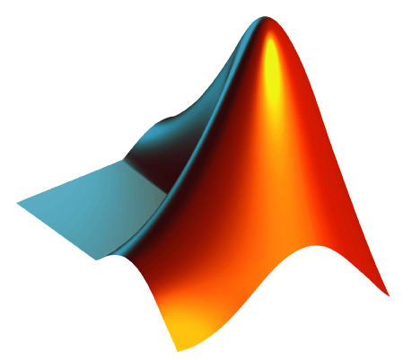


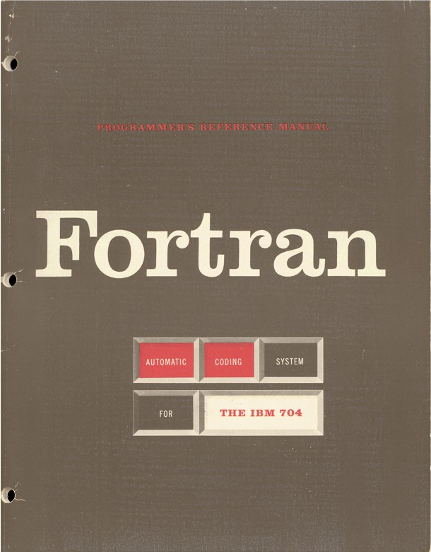
Advantages of Python
Speed of programming
Fewer bugs
No memory allocation bugs
Pythonic paradigm
Ease of learning
Ease of comprehension
Ease of maintenance
Library ecosystem
Fastest growing language
Taken all features of Matlab, R, fortran linalg libraries, Mathematica into one thing
Pandas has absolutely no competitor
Ecosystem integration

Slide 29
Limitations of Python
GIL
Multithreading performance issues
RAM management issues
Weird library promises
Trying to use it without bash is a poor choice
One of the major reasons for WSL

Slide 30
Technical Things
C API
Python 2.7/3
pip /pip3
Fully interpreted
No compile times
Slower to run
Useful for mapreduce
Install scripts, sudo problems
Virtualenv, pyenv
Dynamically typed
Problem with Windows

Slide 31



Alternative Interpreters
Cython
CDefs
Industry
PyPy (both variants)
Jython (note mapreduce)

Slide 32





ML Libraries (I)
Numpy/Scipy Stack
Virtualenv/Pyenv
Pandas
TensorFlow
Keras
Pickle
Scikit-learn (“sklearn”)
Matplotlib (and alternative visualization libraries)

Slide 33



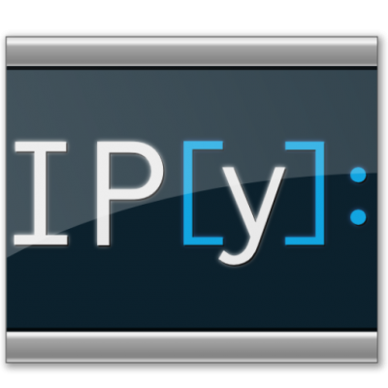

ML Libraries (II)
Spyder, Anaconda
Conda
Pip/apt trick
Flask/Django
RESTful API
IPython
Don’t use this for deployment or RAM intensive stuff if possible
Jupyter Notebooks
Gensim

Slide 34
Why are we here again?
Machine Learning
Python
Linux

Slide 35
Lab

Slide 36
BASH Basics
https://cloud.google.com/
ls (-l, -a)
cd
apt (note apt-get; install; update)
vim (neovim)/nano/emacs
cat
grep
sudo
|
flags
python (-c)
source
mkdir
rmdir
rm
wget
touch
SSH, SCP
pwd
cp
mv
.sh files
pip
./

